Slide 1
Bloodless Glucose Monitor
Presented by: Tom Zhou
Team Members: Cong Zhang and Nelson Wu
Client: Dr. Jeffrey Brooks, D.P.M.

Slide 2
Need
Diabetes mellitus attributed to malfunction of insulin production, a molecule that regulates blood glucose concentrations within the body
Normal glucose level: 70 to 110 mg/dL
Blood glucose spike to 180 mg/dL after meals
Normally brought back down by insulin
Stay high for 3 hours for people with diabetes

Slide 3
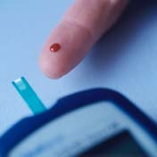
Finger Prick- The Gold Standard
Performs glucose oxidation and measures changes in sample
Costs approximately $1000 per year in test strips
Requires puncturing the skin which often results in neuropathy
Patient is only willing to puncture skin so many times per day, limiting effectiveness of monitoring

Slide 4
Specific Design Requirements
Device does not require implanted parts or physically puncturing the user
Device gives results in a reasonable time frame (within 1 minute)
Device displays blood glucose in standard units (mg glucose/dL blood)
Device warns user on detection of dangerous glucose levels (>200mg/dL or <70mg/dL)
Device is lighter than 20 N and smaller than 200 cm³
Device contains internal power for one month of testing (10 W-hr)
Device is accurate within 10% of the commercially-available methods at least 95% of the time

Slide 5
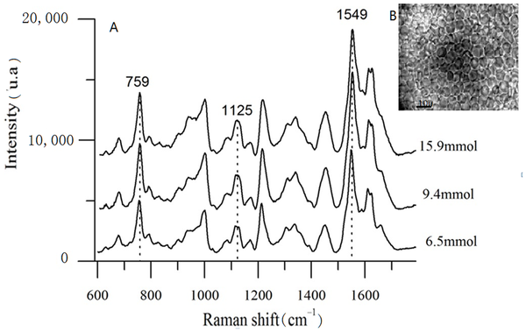
Raman Spectroscopy
Inelastic scattering
785 nm incident
861 nm Glucose
893 nm hemoglobin

Slide 6
Weight
Component: | Quantity: | Part Mass (g): | Total Mass (g):
Case half | 2 | 16.34 | 32.68
Collimation tube | 1 | 8.46 | 8.46
Laser diode | 1 | 2 | 2
Laser diode driver | 1 | 2 | 2
Beam splitter | 2 | 2.47 | 4.94
Filter | 2 | 5.67 | 11.34
Lens | 3 | 2.12 | 6.36
Photodiode | 2 | 2 | 4
Breadboard with Circuit | 1 | <500 | <500
 |  | Total: | 571.78
W=mg=0.572kg*9.8m/s²=5.60 N

Slide 7
Sampling Speed
Measuring backscatter over 60 seconds
Source is unmodulated laser diode
To measure in 100ms interval, only requires 10Hz

Slide 8
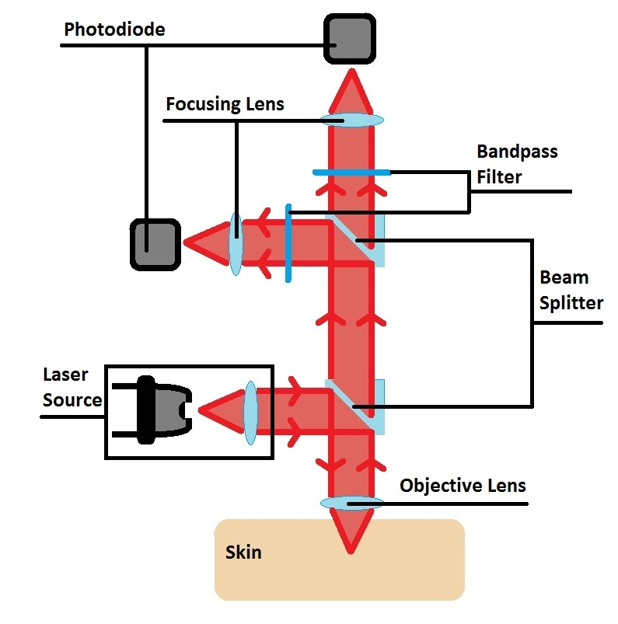
Specific Details of Chosen Design
Optical Elements
Laser source
Beam splitters
Objective and focusing lens
Bandpass filters
Photodetectors
Non-Optical Elements
Data acquisition (DAQ) analogue to digital converter (ADC)
Computation circuit board
Display
Battery
Case

Slide 9
Transimpedance amplifier

Slide 10
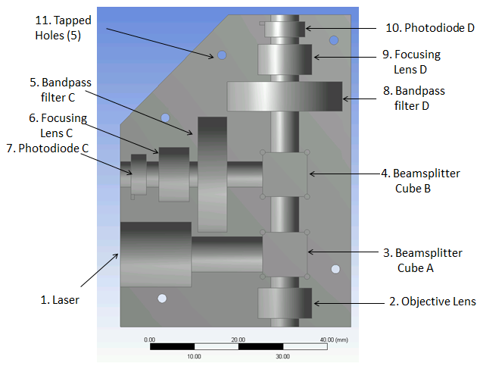

Slide 11
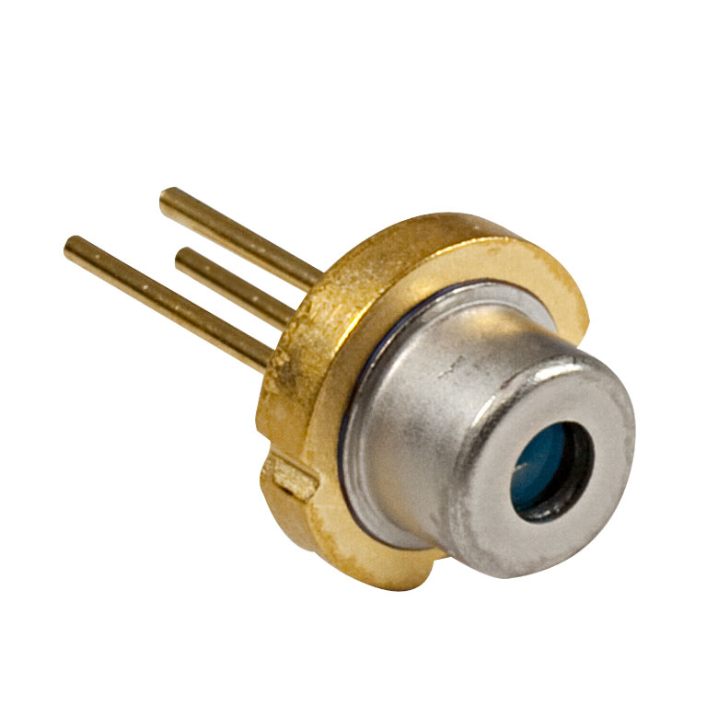
Laser source
QL7816S-B-L
785 nm, 25 mW, Ø5.6 mm, B Pin Code Laser Diode
The laser diode provides a single wavelength light source
A single wavelength light source is preferable to a source of a broad range of wavelengths
As the spectral peaks of glucose and hemoglobin are relative to wavelength of the simulation laser, broader simulation sources will result in broader spectral peaks.

Slide 12
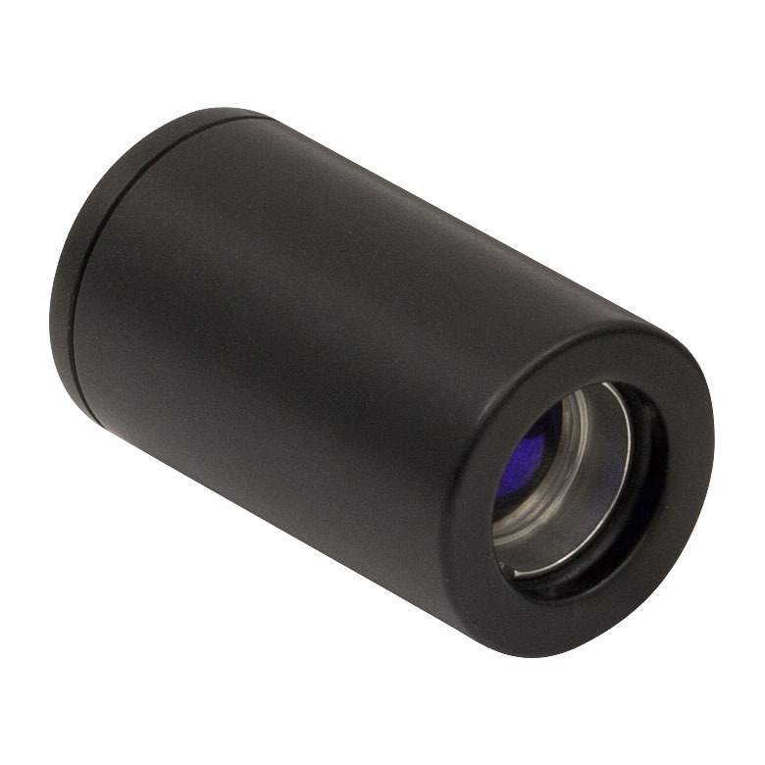
Collimating Lens
LT220P-B
Collimation Tube with Optic for Ø5.6 and Ø9 mm Laser Diodes, f = 11.0 mm
Converts the diverging light from the laser diode to parallel laser light, needed to progress through preceding optical elements
The main consideration of the collimation tube is the width of output collimated light
A width too narrow is prone to optical misalignment whereas a width too wide increases the sizes of optical elements requires

Slide 13
Beam splitters
BS011
50:50 Non-Polarizing Beamsplitter Cube, 700-1100 nm, 10 mm
The main considerations for the beam splitters is the ratio of light intensity between the split. This ratio determines how much of the incoming light will be transmitted through the cube versus deflected 90 degrees.

Slide 14
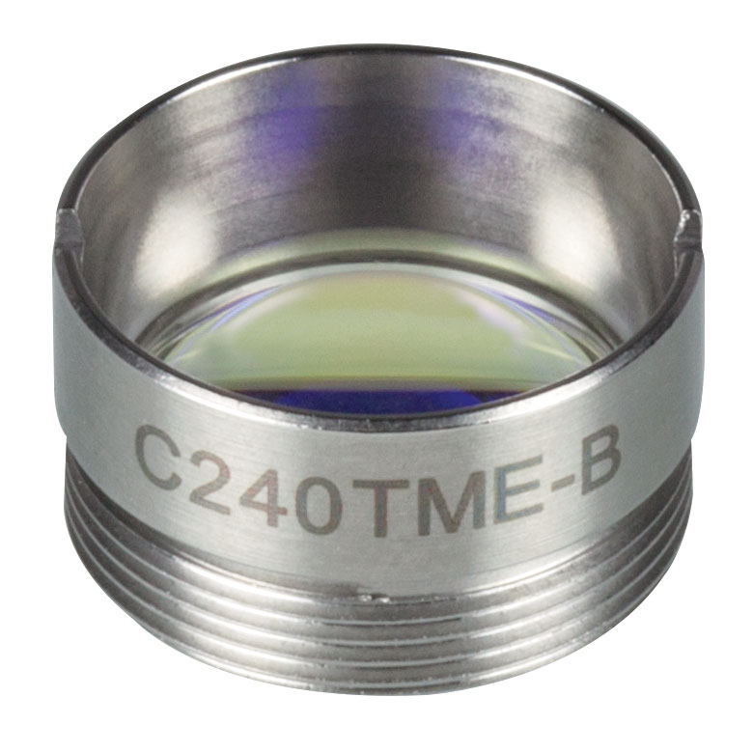
Objective (focusing) lens
C240TME-B
f = 8.0 mm, NA = 0.5, Mounted Geltech Aspheric Lens, AR: 600-1050 nm
The objective lens is used to focus the collimated laser light to a focused spot in the skin, and to capture and collimate the backscattered Raman signal.
The lens must also focus the laser light to a point on a blood vessel near the surface of the skin, as the optical penetration depth at 785 nm is around 1 mm in tissue.

Slide 15
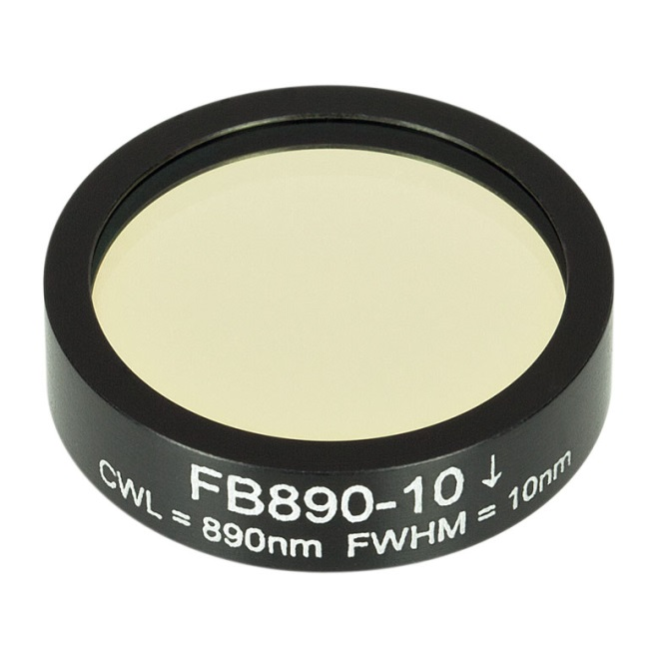
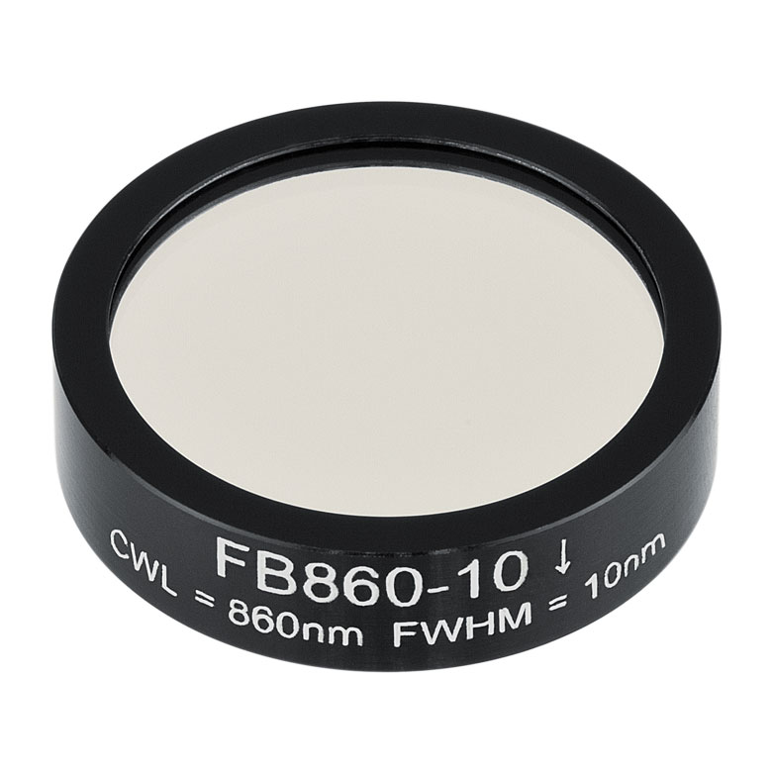
Bandpass filters
Hemoglobin Bandpass filter: FB890-10
Ø1in Bandpass Filter, CWL = 890 ± 2 nm, FWHM = 10 ± 2 nm
Glucose bandpass filter: FB860-10
Ø1in Bandpass Filter, CWL = 860 ± 2 nm, FWHM = 10 ± 2 nm

Slide 16
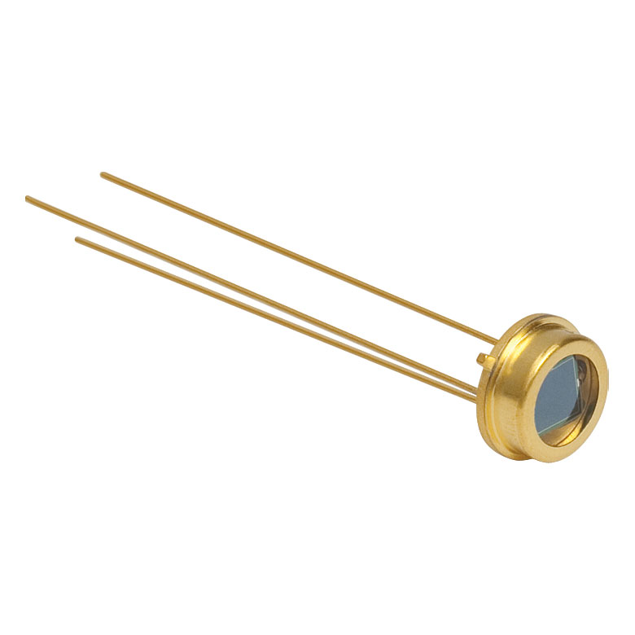
Photodetectors
FDS100
Si Photodiode, 10 ns Rise Time, 350 - 1100 nm, 3.6 mm x 3.6 mm Active Area
The photodetector outputs a current indicative of measured light intensity.
Two photodetectors are used in the device: one to measure the intensity of the glucose peak, the other to measure the intensity of the hemoglobin peak.

Slide 17
Operational Amplifier
INA116
Instrumentation Amplifier
Ultra low input bias (25fA)
Input buffer amplifiers (no impedence matching)

Slide 18
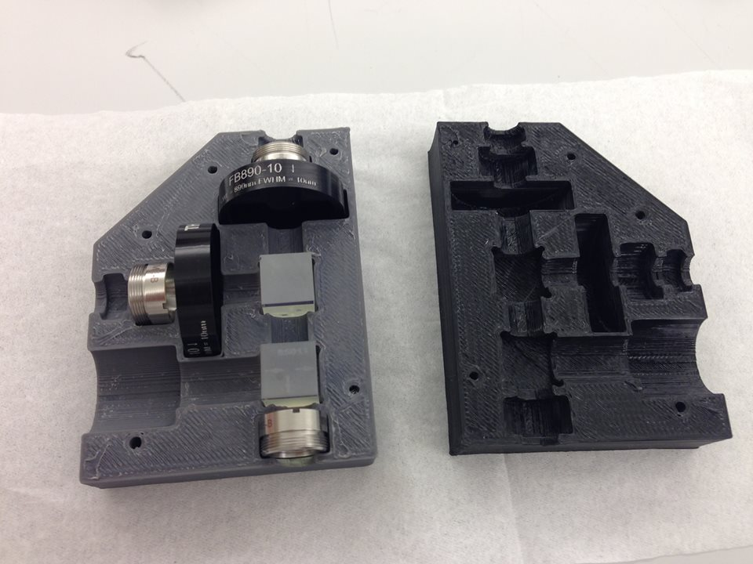

Slide 19
Optical Components
Part Number | Provider | List Price ($) | Quantity | Cost ($)
QL716-B-L | Thor Labs | 11.50 | 1 | 11.50
LD1100 |  | 85.00 | 1 | 85.00
LT220P-B |  | 115.00 | 1 | 115.00
BS011 |  | 164.20 | 2 | 328.40
C240TME-B |  | 79.00 | 3 | 237.00
FB890-10 |  | 91.26 | 1 | 91.26
FB860-10 |  | 91.26 | 1 | 91.26
FDS100 |  | 13.10 | 2 | 26.20
INA116PA | Digi-key | 16.51 | 2 | 33.02
*Shipping |  |  |  | ~9.00
Total |  |  |  | 1027.64
List of Optical Components Required for Prototype
The lead time of these parts range from 3 to 5 business days.

Slide 20
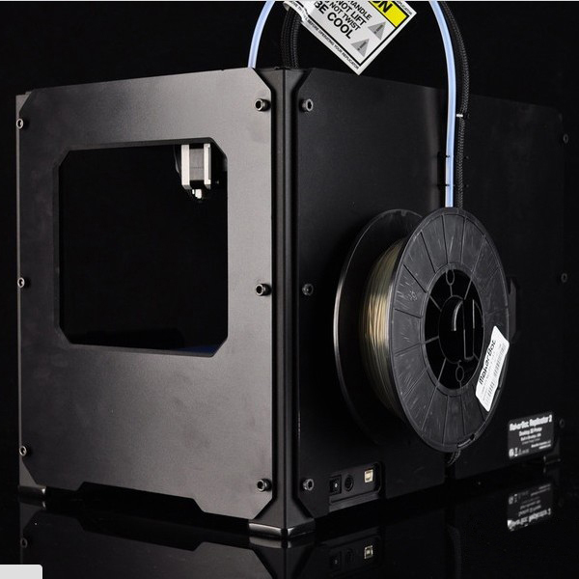
Manufacturing Process
3D Printing
MakerBot R2
Acrylonitrile butadiene styrene (ABS)

Slide 21
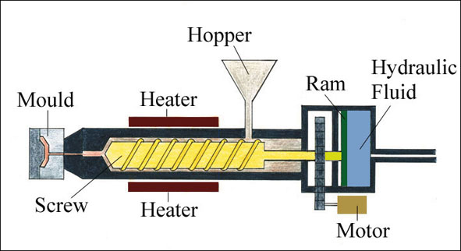
Mass Production: Injection Molds
High initial cost for mold
Low per-unit cost
Estimated initial cost of $6106
ABS pellets cost $1.65/kg
2000 units cost $108

Slide 22
Conclusions
Signal strength is very important
Consider cost as well as effectiveness
Usage of lasers

Slide 23
Future Directions
More prototyping
Clinical testing
Seek FDA approval

Slide 24
Questions?

Slide 25
References
1. Kong et al. “Clinical Feasibility of Raman Spectroscopy for Quantitative Blood Glucose Measurement.” Massachusetts Institute of Technology. 2011.
2. Larin, K. V., M. S. Eledrisi, M. Motamedi, and R. O. Esenaliev. "Noninvasive Blood Glucose Monitoring With Optical Coherence Tomography: A Pilot Study In Human Subjects ." Diabetes Care 25.12 (2002): 2263-2267. Print.
3. N.D. Evans, L. Gnudi, O. J. Rolinski, D. J. S. Birch, and J. C. Pickup. “Non-invasive glucose monitoring by NAD(P)H Autofluorescence spectroscopy in broblasts and adipocytes:a model for skin glucose sensing.” Diabetes Technology and Therapeutics 5 (2003): 807-816. Print.
4. Pishko, Michael V.. "Analysis: Glucose Monitoring By Reverse Iontophoresis." Diabetes Technology Therapeutics 2.2 (2000): 209-210. Print.
5. Plaitez, Miguel, Tobias Leiblein, and Alexander Bauer. "In Vivo Noninvasive Monitoring of Glucose Concentration in Human Epidermis by Mid-Infrared Pulsed Photoacoustic Spectroscopy." Analytical Chemistry 85.2 (2013): 1013-1020. Print.
6. Potts, Russel, Janet Tamada, and Micheal Tearny. "Glucose monitoring by reverse iontophoresis." Diabetes/metabolism research and reviews 18 (2002): 49-53. Print.
7. Shao et al. “In Vivo Blood Glucose Quantification Using Raman Spectroscopy.” Fuzhou University. 2012.
8. Thenadil, Suresh, and Jessica Rennert. "Comparison of Glucose Concentration in Interstitial Fluid, and Capillary and Venous Blood During Rapid Changes in Blood Glucose Levels." Diabetes Technology & Therapeutics 3.3 (2004): 357-365. Print.
9. Whiting, D., Weil, C., & Shaw, J. (2011). IDF Diabetes Atlas: Global estimates of the prevalence of diabetes for 2011 and 2030. Diabetes Research and Clinical Practice, 94(3), 311-321.
10. Vashist, Sandeep. "Non-invasive glucose monitoring technology in diabetes management: A review." Analytica Chimica Acta 750 (2012): 16-27. Print.
11. Yang, Chaoshin, Chiawei Chang, and Jenshinn Lin. "A Comparison between Venous and Finger-Prick Blood Sampling on Values of Blood Glucose." International Conference on Nutrition and Food Sciences 39 (2012): 207-210. Print.
12. Zhang, Ping, Xinzhi Zhang, and Jonathan Brown. "Global healthcare expenditure on diabetes for 2010 and 2030." Diabetes Research and Clinical Practice 87.3 (2010): 293-301. Print.

