Slide 1
Bloodless Glucose Monitor
Presented by: Nelson Wu
Team Members: Cong Zhang and Tom Zhou
Client: Dr. Jeffrey Brooks, D.P.M.

Slide 2
Need
Diabetes mellitus attributed to malfunction of insulin production, a molecule that regulates blood glucose concentrations within the body
Normal glucose level: 70 to 110 mg/dL
Blood glucose spike to 180 mg/dL after meals
Normally brought back down by insulin
Stay high for 3 hours for people with diabetes

Slide 3
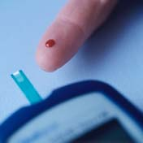
Finger Prick- The Gold Standard
Performs glucose oxidation and measures changes in sample
Costs approximately $1000 per year in test strips
Requires puncturing the skin which often results in neuropathy
Patient is only willing to puncture skin so many times per day, limiting effectiveness of monitoring

Slide 4
Specific Design Requirements
Device does not require implanted parts or physically puncturing the user
Device gives results in a reasonable time frame (within 1 minute)
Device displays blood glucose in standard units (mg glucose/dL blood)
Device warns user on detection of dangerous glucose levels (>200mg/dL or <70mg/dL)
Device is lighter than 20 N and smaller than 200 cm³
Device contains internal power for one month of testing (10 W-hr)
Device is accurate within 10% of the commercially-available methods at least 95% of the time

Slide 5
Design Possibilities
Reverse Iontophoresis
Photoacoustic Effect
Optical Coherence Tomography
Multispectral Polarimetry
Near-Infrared Spectroscopy
Raman Spectroscopy

Slide 6
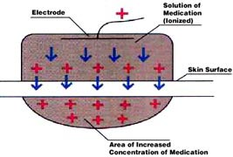
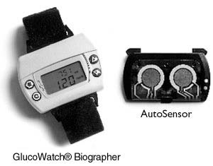
Reverse Iontophoresis
Extracting glucose in fluid drawn from skin using electrical current
Example: G2 Glucowatch, US patent 20080058627
Causes skin irritation
Requires daily “finger-prick” calibration
Disrupted by sweating
Notes:
Pro: Was on the market, and technically noninvasive

Slide 7
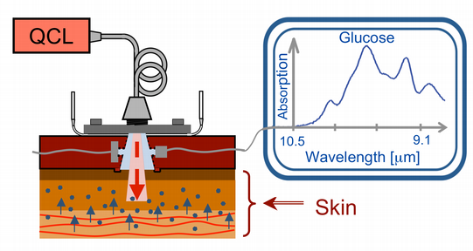
Photoacoustic Effect
Use laser pulse to heat tissue
Measure thermal tissue expansion and acoustic wave
Calculate fluid viscosity and correlative glucose concentration
Not affected by water itself due to poor response
Fluid viscosity confounded

Slide 8
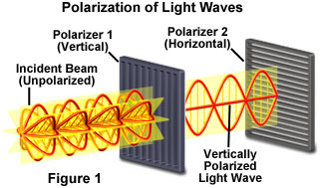
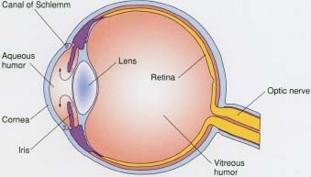
Multispectral Polarimetry
Measures the intensity of collected polarized light.
Requires low turbidity (i.e. aqueous humor of the eye)
Unaffected by temperature and pH
Time lag

Slide 9
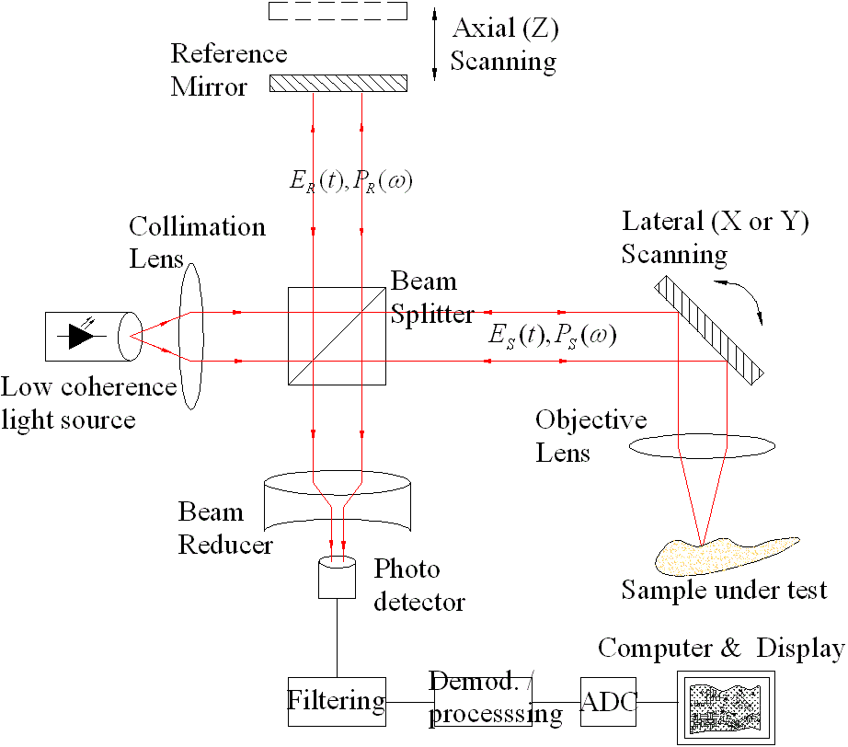
Optical Coherence Tomography
Based on the delay of backscattered light compared to the light reflected by the reference arm mirror
High resolution two-dimensional images by in-depth and lateral scanning
Twenty minute lag from blood glucose levels
The refractive index of the interstitial fluid increases in response to increase in its glucose concentration
Sensitive to motion artifacts and changes in skin temperature
Notes:
The scanning of in-depth tissues (up to 1 mm depth) and tissue surface are done by moving the mirror into the reference and sample arm of the interferometer, respectively.

Slide 10
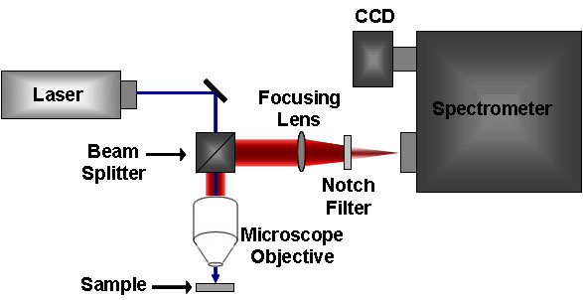
Near Infrared Spectroscopy
Raman Spectroscopy
Measures elastic scattering of light
Strong Water Spectrum
785 nm for 1 mm tissue penetration
Weak tissue autofluorescence
Less photodamage
Measures inelastic scattering of light
Weak Water Spectrum
785 nm for 1 mm tissue penetration
Weak tissue autofluorescence
Less photodamage

Slide 11
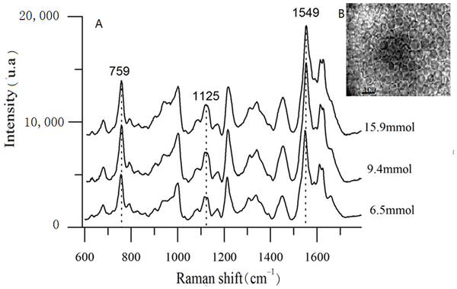
Raman Spectroscopy
785 nm incident
861 nm Glucose
893 nm hemoglobin

Slide 12
Overview
Invasive:
Blood pricking method
Reverse Iontophoresis
Indirect:
Photoacoustic Effect
Non-invasive
Direct
Monitor location: Eye
Multispectral Polarimetry
Monitor location: Skin
Interstitial Space:
Optical Coherence Tomography
Capillaries
Elastic:
NIR Spectroscopy
Inelastic:
Raman Spectroscopy

Slide 13
Analysis to Choose Design
Option | Non-invasive | Accuracy | Portability | Ease of Use | Cost | Total
Blood Prick | 1 | 5 | 5 | 4 | 3 | 18
Reverse Iontophoresis | 3 | 3 | 5 | 2 | 3 | 16
Photoacoustic Effect | 5 | 2 | 3 | 2 | 2 | 14
Multispectral Polarimetry | 5 | 4 | 2 | 1 | 3 | 15
Optical Coherence Tomography | 5 | 3 | 2 | 3 | 2 | 15
NIR | 5 | 3 | 5 | 4 | 3 | 20
Raman | 5 | 5 | 5 | 4 | 3-4 | 23

Slide 14
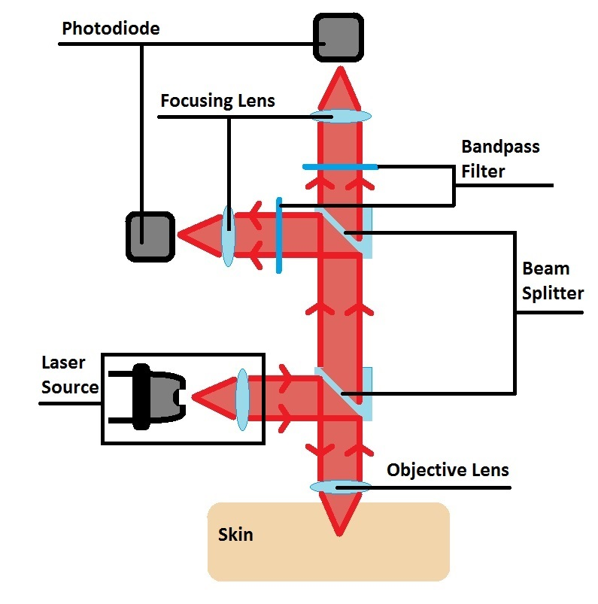
Specific Details of Chosen Design
Optical Elements
Laser source
Beam splitters
Objective and focusing lens
Bandpass filters
Photodetectors
Non-Optical Elements
Data acquisition (DAQ) analogue to digital converter (ADC)
Computation circuit board
Display
Battery
Case

Slide 15
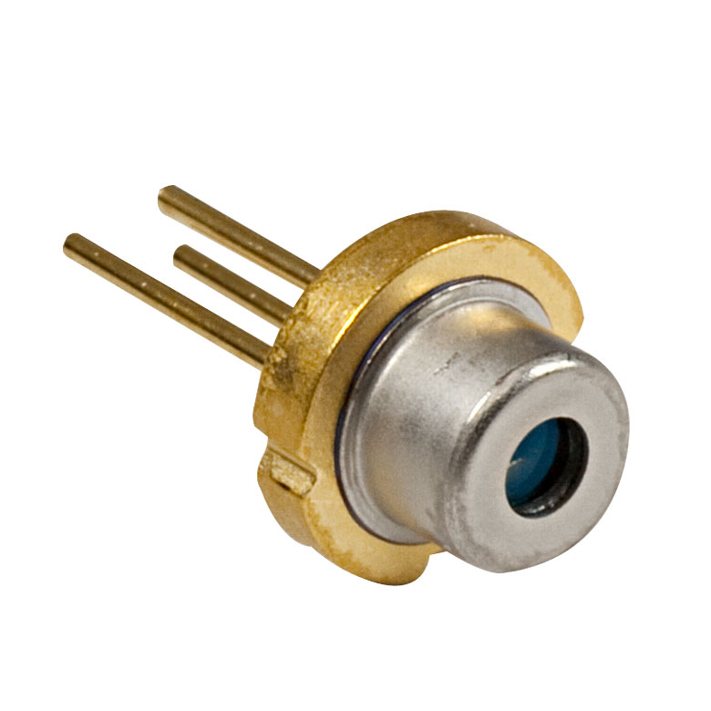
Laser source
QL7816S-B-L
785 nm, 25 mW, Ø5.6 mm, B Pin Code Laser Diode
The laser diode provides a single wavelength light source
A single wavelength light source is preferable to a source of a broad range of wavelengths
As the spectral peaks of glucose and hemoglobin are relative to wavelength of the simulation laser, broader simulation sources will result in broader spectral peaks.

Slide 16
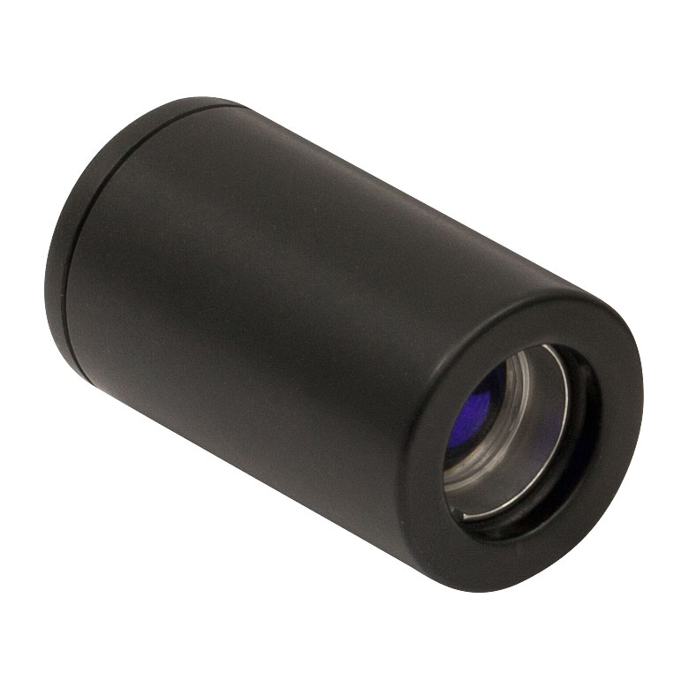
Collimating Lens
LT220P-B
Collimation Tube with Optic for Ø5.6 and Ø9 mm Laser Diodes, f = 11.0 mm
Converts the diverging light from the laser diode to parallel laser light, needed to progress through preceding optical elements
The main consideration of the collimation tube is the width of output collimated light
A width too narrow is prone to optical misalignment whereas a width too wide increases the sizes of optical elements requires

Slide 17
Beam splitters
BS011
50:50 Non-Polarizing Beamsplitter Cube, 700-1100 nm, 10 mm
The main considerations for the beam splitters is the ratio of light intensity between the split. This ratio determines how much of the incoming light will be transmitted through the cube versus deflected 90 degrees.

Slide 18
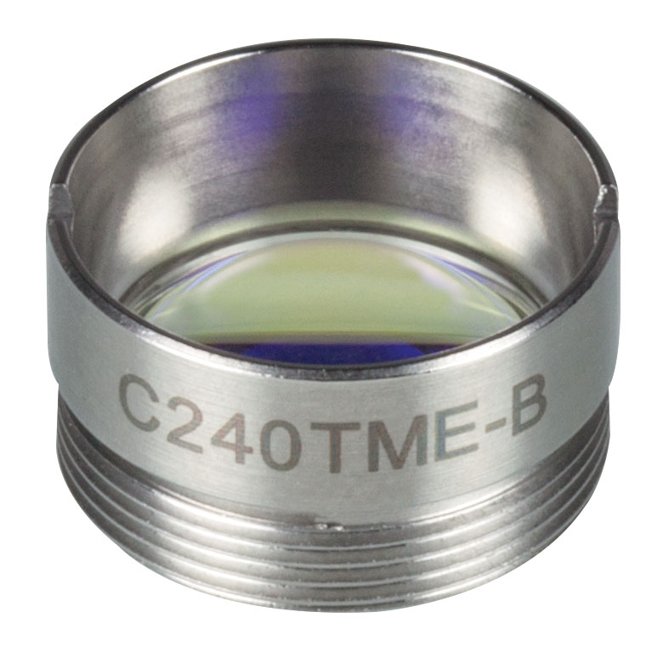
Objective (focusing) lens
C240TME-B
f = 8.0 mm, NA = 0.5, Mounted Geltech Aspheric Lens, AR: 600-1050 nm
The objective lens is used to focus the collimated laser light to a focused spot in the skin, and to capture and collimate the backscattered Raman signal.
The lens must also focus the laser light to a point on a blood vessel near the surface of the skin, as the optical penetration depth at 785 nm is around 1 mm in tissue.

Slide 19
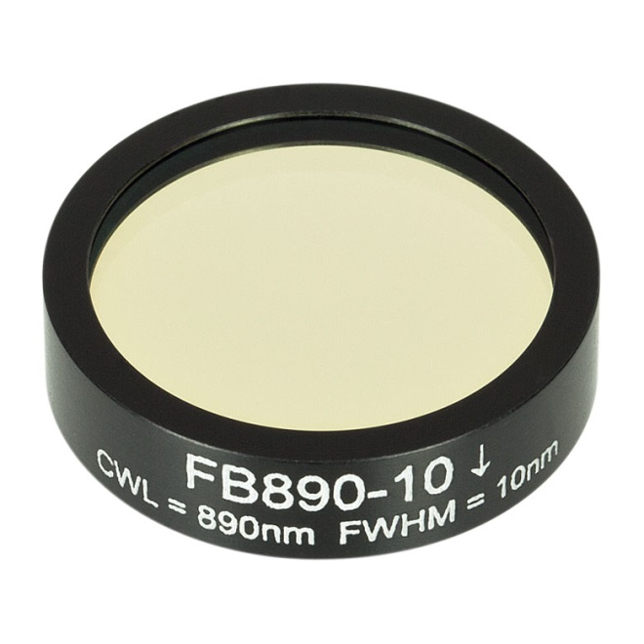
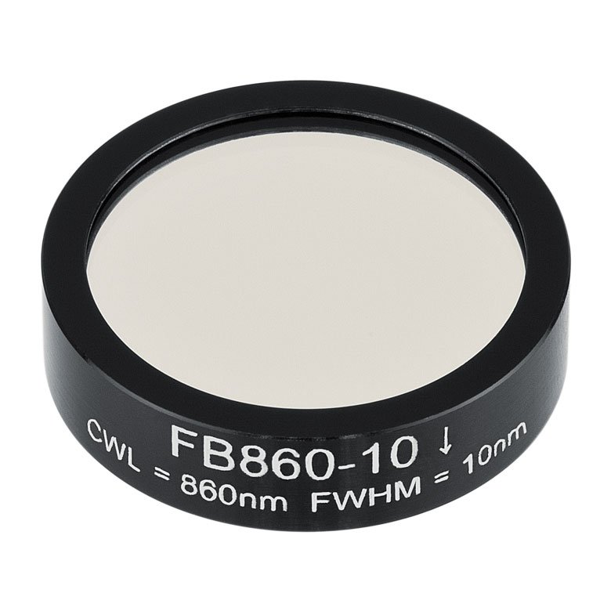
Bandpass filters
Hemoglobin Bandpass filter: FB890-10
Ø1in Bandpass Filter, CWL = 890 ± 2 nm, FWHM = 10 ± 2 nm
Glucose bandpass filter: FB860-10
Ø1in Bandpass Filter, CWL = 860 ± 2 nm, FWHM = 10 ± 2 nm

Slide 20
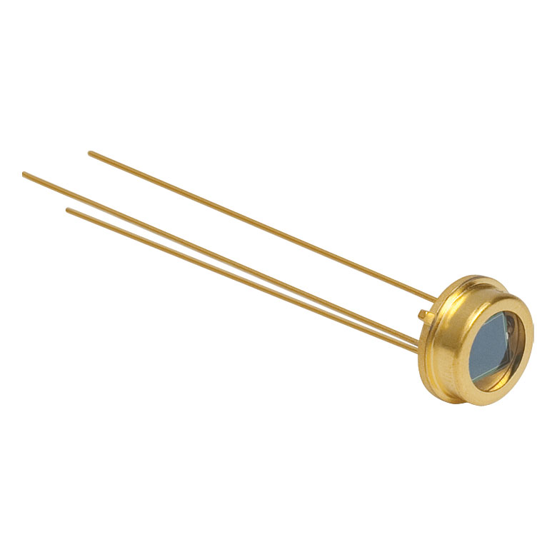
Photodetectors
FDS100
Si Photodiode, 10 ns Rise Time, 350 - 1100 nm, 3.6 mm x 3.6 mm Active Area
The photodetector outputs a current indicative of measured light intensity.
Two photodetectors are used in the device: one to measure the intensity of the glucose peak, the other to measure the intensity of the hemoglobin peak.

Slide 21
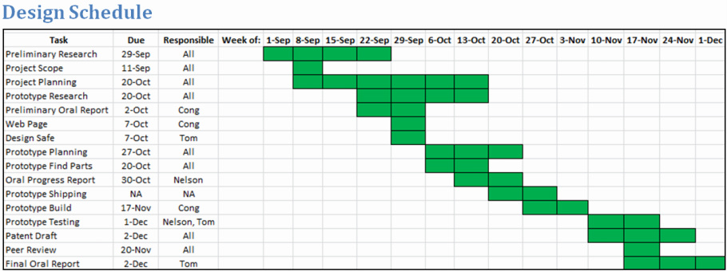
Updated Design Schedule

Slide 22
Updated Team Responsibilities
Nelson Wu
Contact for Client
Website Moderator
Knowledge on alternative spectroscopies
Cong Zhang
Knowledge on Optical Components
Knowledge on Raman Spectroscopy
Tom Zhou
Knowledge on Non-Optical Components
Programmer

Slide 23
Questions?

Slide 24
References
1. Kong et al. “Clinical Feasibility of Raman Spectroscopy for Quantitative Blood Glucose Measurement.” Massachusetts Institute of Technology. 2011.
2. Larin, K. V., M. S. Eledrisi, M. Motamedi, and R. O. Esenaliev. "Noninvasive Blood Glucose Monitoring With Optical Coherence Tomography: A Pilot Study In Human Subjects ." Diabetes Care 25.12 (2002): 2263-2267. Print.
3. N.D. Evans, L. Gnudi, O. J. Rolinski, D. J. S. Birch, and J. C. Pickup. “Non-invasive glucose monitoring by NAD(P)H Autofluorescence spectroscopy in broblasts and adipocytes:a model for skin glucose sensing.” Diabetes Technology and Therapeutics 5 (2003): 807-816. Print.
4. Pishko, Michael V.. "Analysis: Glucose Monitoring By Reverse Iontophoresis." Diabetes Technology Therapeutics 2.2 (2000): 209-210. Print.
5. Plaitez, Miguel, Tobias Leiblein, and Alexander Bauer. "In Vivo Noninvasive Monitoring of Glucose Concentration in Human Epidermis by Mid-Infrared Pulsed Photoacoustic Spectroscopy." Analytical Chemistry 85.2 (2013): 1013-1020. Print.
6. Potts, Russel, Janet Tamada, and Micheal Tearny. "Glucose monitoring by reverse iontophoresis." Diabetes/metabolism research and reviews 18 (2002): 49-53. Print.
7. Shao et al. “In Vivo Blood Glucose Quantification Using Raman Spectroscopy.” Fuzhou University. 2012.
8. Thenadil, Suresh, and Jessica Rennert. "Comparison of Glucose Concentration in Interstitial Fluid, and Capillary and Venous Blood During Rapid Changes in Blood Glucose Levels." Diabetes Technology & Therapeutics 3.3 (2004): 357-365. Print.
9. Whiting, D., Weil, C., & Shaw, J. (2011). IDF Diabetes Atlas: Global estimates of the prevalence of diabetes for 2011 and 2030. Diabetes Research and Clinical Practice, 94(3), 311-321.
10. Vashist, Sandeep. "Non-invasive glucose monitoring technology in diabetes management: A review." Analytica Chimica Acta 750 (2012): 16-27. Print.
11. Yang, Chaoshin, Chiawei Chang, and Jenshinn Lin. "A Comparison between Venous and Finger-Prick Blood Sampling on Values of Blood Glucose." International Conference on Nutrition and Food Sciences 39 (2012): 207-210. Print.
12. Zhang, Ping, Xinzhi Zhang, and Jonathan Brown. "Global healthcare expenditure on diabetes for 2010 and 2030." Diabetes Research and Clinical Practice 87.3 (2010): 293-301. Print.

