Slide 1
Non-Invasive Glucose Monitoring Device
Presenter: Cong Zhang
Group 20
Team Members: Nelson Wu and Tom Zhou
Client: Dr. Jeffrey Brooks, D.P.M.

Slide 2
What is this symbol?

Slide 3
Background: Diabetes
Diabetes mellitus attributed to malfunction of insulin production, a molecule that regulates blood glucose concentrations within the body
Type 1
Type 2
Normal glucose level: 70 to 110 mg/dL
Blood glucose spike to 180 mg/dL after meals
Normally brought back down by insulin
Stay high for 3 hrs for people with diabetes
Notes:
http://www.diabetesbluecircle.org/

Slide 4
Background: Statistics
2000: over 171 million people with diabetes worldwide
Projected 2030: 366 million, according to WHO
In 2010, four million people died to diabetes
Cost US 132 billion, or 20% of total private healthcare spending (2002)

Slide 5
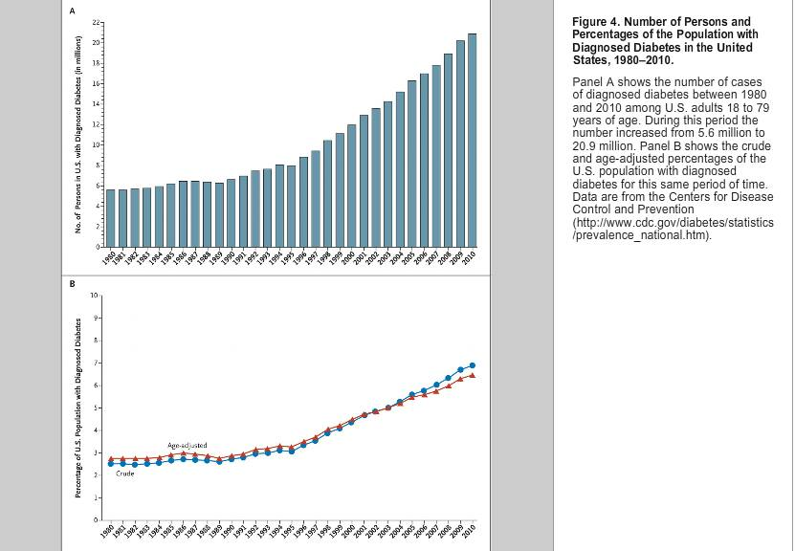
Notes:
Cong’s paper

Slide 6
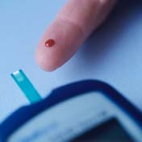
Finger-Prick Glucose Meter
“Gold standard”
Performs glucose oxidation and measures changes in sample
10% of US population have a phobia of needles
Uses costly disposable test strips
Requires puncturing the skin often results in neuropathy
Notes:
Gold standard. Picture: http://www.nhs.uk/Conditions/Diabetes-type1/PublishingImages/M725436-Diabetes_blood_testing-SPL.176x176.jpg

Slide 7
Problem
Monitoring blood glucose concentration is costly and painful for people with diabetes mellitus

Slide 8
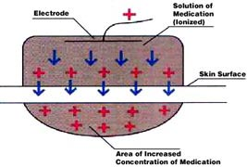
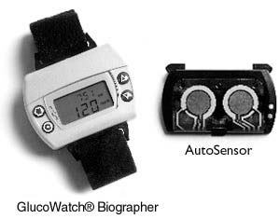
Reverse Iontophoresis
Extracting glucose in fluid drawn from skin using electrical current
Example: G2 Glucowatch, US patent 20080058627
Causes skin irritation
Twenty minute lag from blood glucose levels
Requires daily “finger-prick” calibration
Disrupted by sweating
Notes:
Image: http://www.computescotland.com/images/RbwK6WztbjrTViVx27xg07f050.jpg

Slide 9
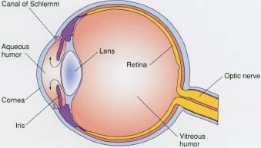
Optical Coherence Tomography
Optical scattering properties change as glucose concentration change
Requires non-turbulent liquid (i.e. aqueous humor of the eye)
US patent 7254429 B2

Slide 10
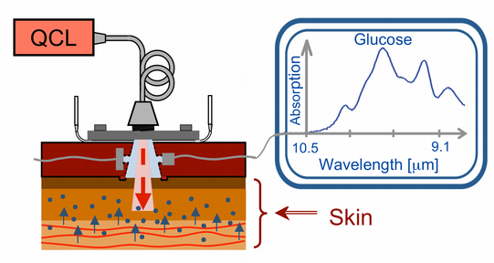
Photo Acoustic Effect
Use laser pulse to heat tissue
Measure thermal tissue expansion and acoustic wave
Calculate fluid viscosity and correlative glucose concentration
Notes:
Image: http://www.lss.ethz.ch/research/projects/glucose/glu_2.png

Slide 11
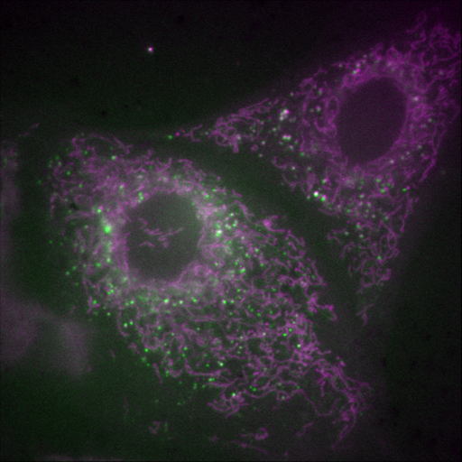
Tissue Autofluorescence
Reduced nicotinamide adenine dinucleotide (NADH) and NAD(P)H, the phosphorylated derivative, release light
Naturally found in body
Concentrations change during glucose metabolism
Massive delay between actual blood glucose levels and these metabolic derivatives
Notes:
http://ihcp.jrc.ec.europa.eu/our_labs/hts/autofluorescence-microscopy-a-non-destructive-tool-to-monitor-mitochondrial-toxicity

Slide 12
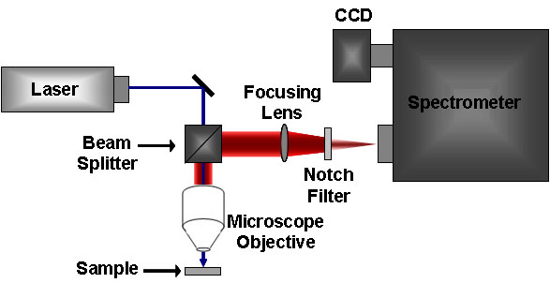
Near IR and Raman Spectroscopy
Glucose scatters light characteristic of bonds in the molecule
Interactions between photons and the electron cloud of glucose produce unique scattering spectra

Slide 13
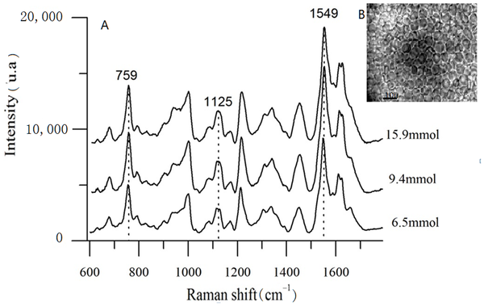
Near IR and Raman Spectroscopy
Directly measures glucose
Near IR show strong water spectra
Raman lack water spectra but is a weaker effect

Slide 14
Scope
Deliver a user-friendly, noninvasive, and portable device that can accurately measure and display the user’s transient blood glucose concentration.

Slide 15
User and User-Friendly
User will be population of adults with diabetes mellitus in the US
User-friendly entails majority of user are able to operate device with minimal effort, practice, and user error
Device gives result in less than one minute
Device displays blood glucose concentration in standard units of mg glucose/dL blood
Device visually warn user on detecting dangerous glucose levels (>200mg/dL or <70mg/dL)

Slide 16
Non-invasive
Measure glucose concentration in the blood without employing implanted parts or physically puncture the user
No successful non-invasive device on market
Finger-pricks is minimally invasive
Reverse iontophoresis causes rashes and needs daily finger-prick calibration

Slide 17
Portable
Device is transportable and usable in everyday settings
Lighter than 5 lb
Smaller than quarter of a cubic foot
Durable, no loose parts
Contains internal power supply for month of testing
Majority of energy used in computing
$$\frac{4 test}{day}∗\frac{30 day}{month}∗\frac{1min}{test}∗\frac{1hr}{60min} =\frac{2hr}{month}$$
$$2hr∗\frac{10Watts}{device}∗\frac{device}{12volts}= 10. 0 Watt hr$$

Slide 18
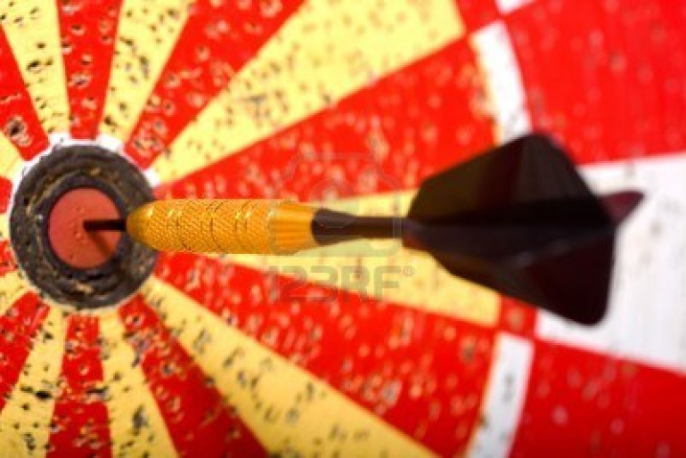
Accuracy and Precision
Range from 50mg/dL to 400 mg/dL
Device reading must be within 10% of reading from a standard commercial “finger-prick” device 95% of the time or better

Slide 19
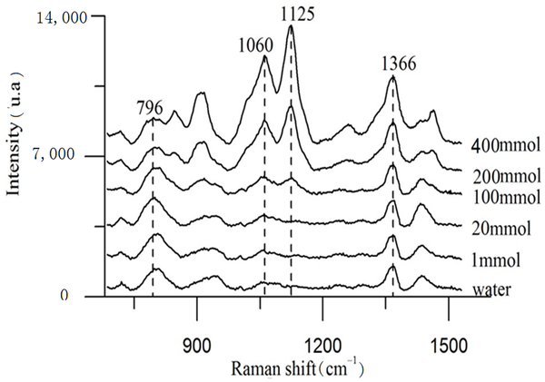
Initial Direction
Recreate Raman spec results using 1M glucose with 785 nm, 0.5 mW laser
Publication used physiological concentrations of glucose with 785 nm, 15 mW laser

Slide 20
Schedule

Slide 21
Team Roles
Cong Zhang
Primary Programmer
Primary contact to research contacts
Nelson Wu
Primary contact to Client
Secondary Programmer
Web Page Manager
Tom Zhou
Primary Designer
Secondary Programmer

Slide 22
Works Cited
Kong et al. “Clinical Feasibility of Raman Spectroscopy for Quantitative Blood Glucose Measurement.” Massachusetts Institute of Technology. 2011.
Larin, K. V., M. S. Eledrisi, M. Motamedi, and R. O. Esenaliev. "Noninvasive Blood Glucose Monitoring With Optical Coherence Tomography: A Pilot Study In Human Subjects ." Diabetes Care 25.12 (2002): 2263-2267. Print.
Pishko, Michael V.. "Analysis: Glucose Monitoring By Reverse Iontophoresis." Diabetes Technology Therapeutics 2.2 (2000): 209-210. Print.
Plaitez, Miguel, Tobias Leiblein, and Alexander Bauer. "In Vivo Noninvasive Monitoring of Glucose Concentration in Human Epidermis by Mid-Infrared Pulsed Photoacoustic Spectroscopy." Analytical Chemistry 85.2 (2013): 1013-1020. Print.
Potts, Russel, Janet Tamada, and Micheal Tearny. "Glucose monitoring by reverse iontophoresis." Diabetes/metabolism research and reviews 18 (2002): 49-53. Print.
Shao et al. “In Vivo Blood Glucose Quantification Using Raman Spectroscopy.” Fuzhou University. 2012.
Thenadil, Suresh, and Jessica Rennert. "Comparison of Glucose Concentration in Interstitial Fluid, and Capillary and Venous Blood During Rapid Changes in Blood Glucose Levels." Diabetes Technology & Therapeutics 3.3 (2004): 357-365. Print.
Whiting, D., Weil, C., & Shaw, J. (2011). IDF Diabetes Atlas: Global estimates of the prevalence of diabetes for 2011 and 2030. Diabetes Research and Clinical Practice, 94(3), 311-321.
Vashist, Sandeep. "Non-invasive glucose monitoring technology in diabetes management: A review." Analytica Chimica Acta 750 (2012): 16-27. Print.
Yang, Chaoshin, Chiawei Chang, and Jenshinn Lin. "A Comparison between Venous and Finger-Prick Blood Sampling on Values of Blood Glucose." International Conference on Nutrition and Food Sciences 39 (2012): 207-210. Print.
Zhang, Ping, Xinzhi Zhang, and Jonathan Brown. "IDF Diabetes Atlas: Global estimates of the prevalence of diabetes for 2011 and 2030." Diabetes Research and Clinical Practice 87.3 (2010): 293-301. Print.

